Slide 1
Observing ‘threshold channel’ in collider
The heuristic estimation

Slide 2


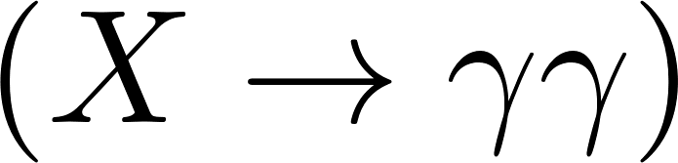
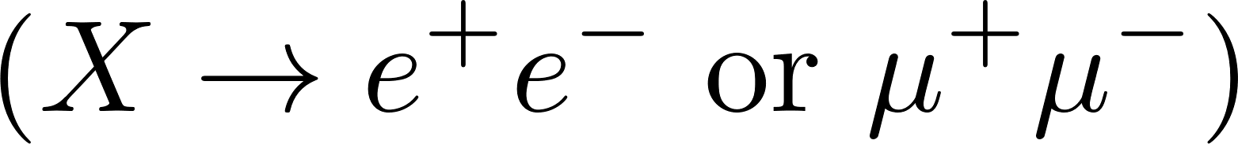
Target : Unstable massive scalar , much heavier than Higgs
Question : “Is there any hidden decay channel of whose threshold is close to ?
I will call this ‘a threshold channel’ for simplicity
Precondition : The target resonance itself must be visible.
What would be the cleanest decay channel?
Candidates : diphoton , dilepton

Slide 3
Hypothesis testing scenarios
Our case!
Scenario 1: Discovering an NP resonance
Scenario 2: Discovering a threshold channel
Few model parameters
(mass, width, … , etc.)
More model parameters
(mass, width, threshold, couplings, … , etc.)
Fixed SM prediction
Model parameters (mass, width, … , etc.)
+
vs
Null hypothesis (B)
Signal by NP resonance (S)
Null hypothesis
Alt hypothesis
(there is no NP resonance)
(Breit-Wigner, no threshold channel)
(threshold channel loop effect)
vs
In theory, we can perform a hypothesis testing between
null hypothesis and alt hypothesis as in scenario 1 to
determine whether the null hypothesis is rejected or not.
However, the full statistical analysis would be lengthy, so
we have to pre-restrict the parameter space.
Hence, we need a heuristic estimation.
=
Alt hypothesis (B+S)
(there is NP resonance)
If the experiment result is not explainable under B with
statistical fluctuation but explainable under B+S (best fit),
then we may claim that we discovered a new physics signal.

Slide 4
‘Heuristic estimation’
Many papers on sensitivity of detecting resonance are based on scenario 1. We should harvest something out of these papers
and apply it in our case.
In a rough sense, if S is big enough comparing to fluctuations of B then we can distinguish between S and B.
However, in scenario 2, it is ambiguous what is signal and what is background.
In scenario 1, the background B = (Null) and the signal S = (Alt – Null).
By analogy, we want to regard B = (Null) and S = (Alt – Null) also in scenario 2.
The difference is that the null hypothesis also contains some model parameters, so we may alter the definition so that
B = (Best fit under Null) and S = (Alt – Best fit under Null).
Another obstacle is that there is a detector smearing due to the limited resolution of invariant mass measurement.
A detector smearing effectively blurs the positive part and negative part of S so it is cancelled.
Intuitively speaking, the lower the precision of the measurement, the harder it is to find out the details of the resonance signal.
Instead of explicitly convoluting the smearing function(Gaussian or crystal-ball function), we will simply require that
the width of X should be greater than the uncertainty scale of invariant mass measurements.
Our strategy: calculate the ‘pseudo-cross-section’ based on |S| to see whether we can discover threshold effects.

Slide 5

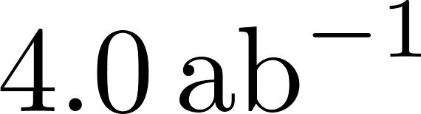

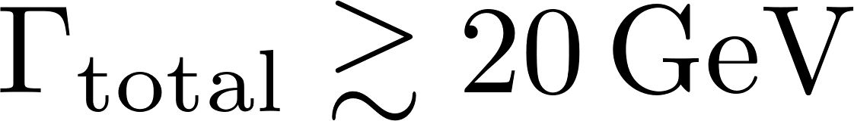
Benchmark analysis points and parameters
Charged leptons
Model:
Experiment: in linear electron collider, ,
Same Yukawa coupling for all charged leptons
Mass : 400 GeV (Can be produced in both ILC and LHC)
Momentum resolution: ~5% for dimuon (typical in ATLAS, CMS)
⇒
2212.07338
Every calculation is done in real-on-shell scheme.

Slide 6
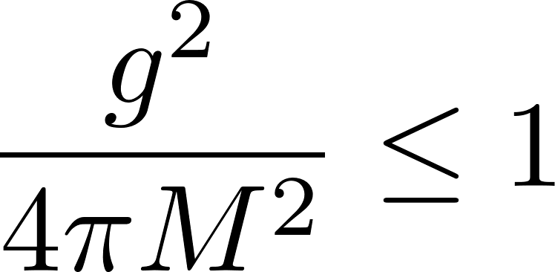
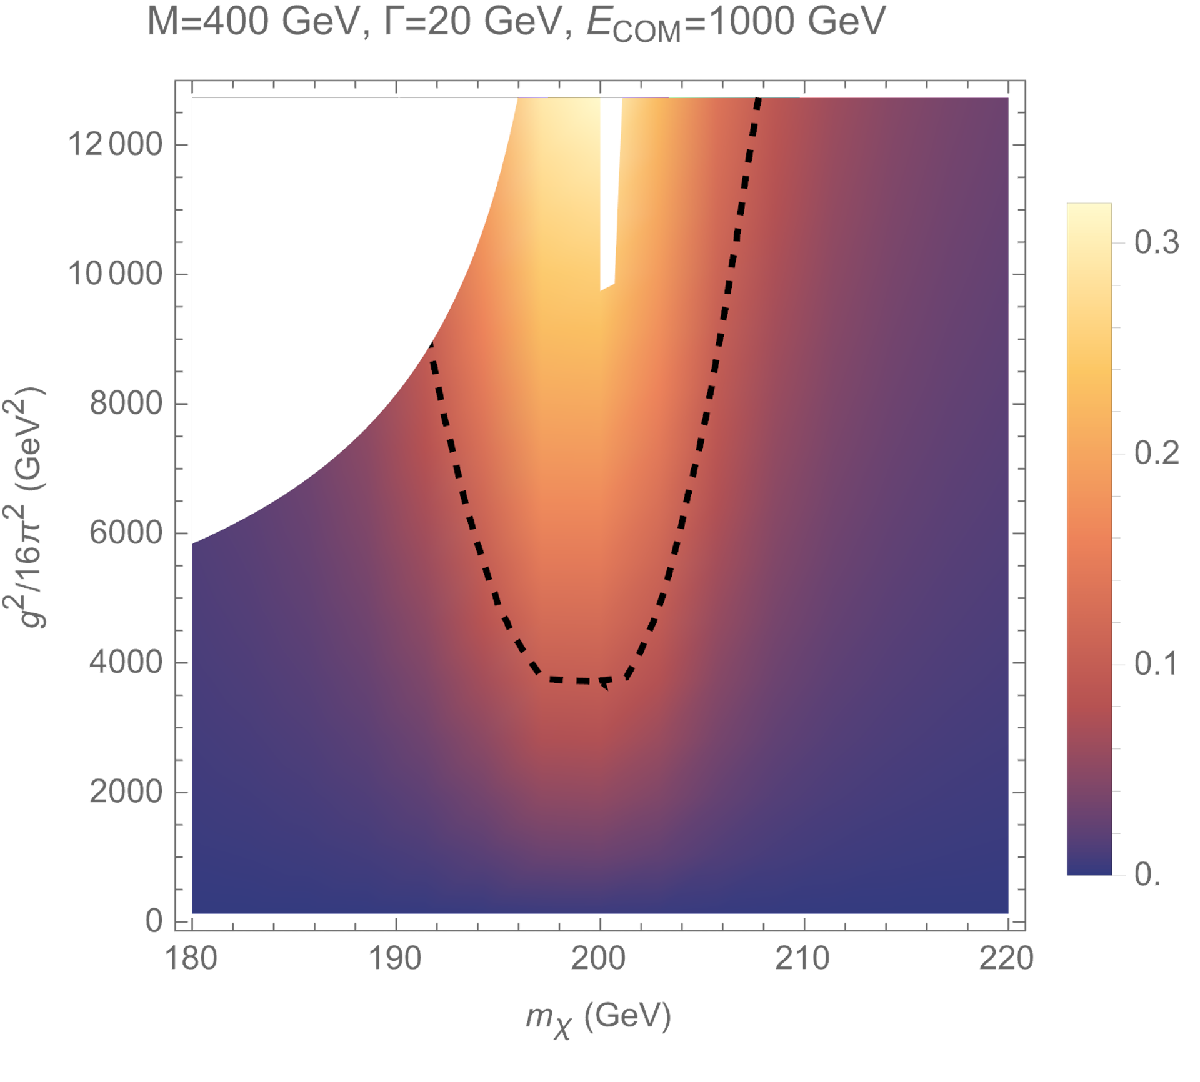
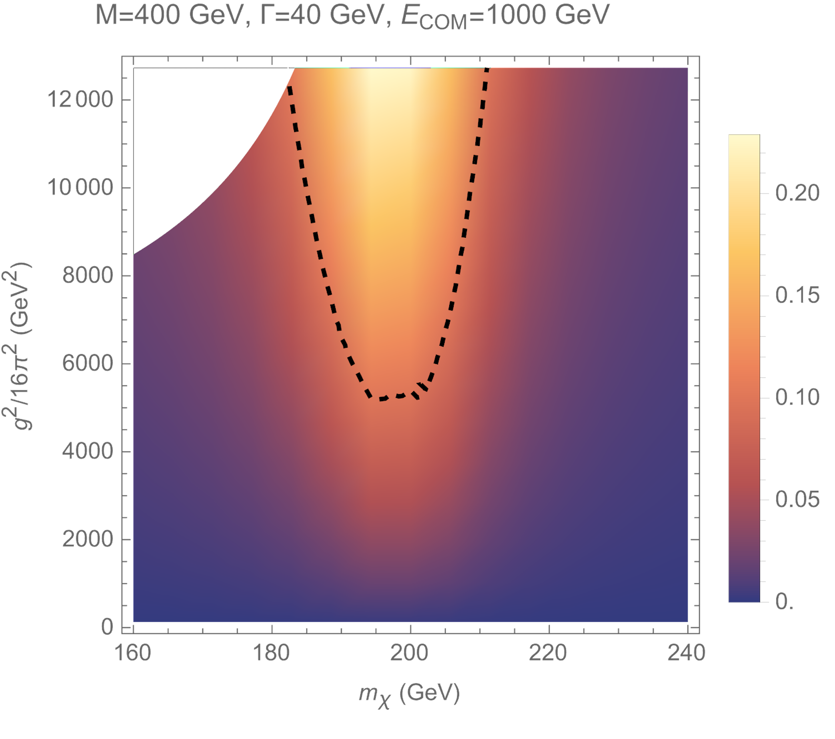
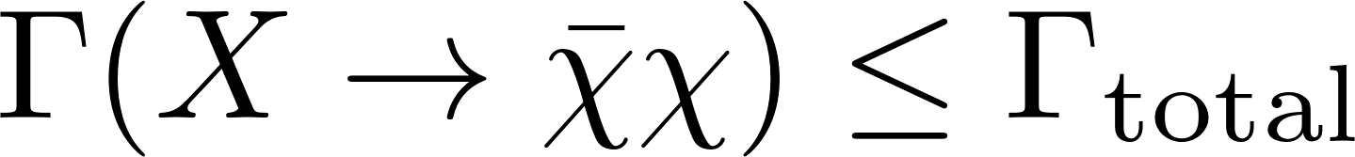
Resonance signal cross section vs Threshold channel signal cross section
Above the dashed line, threshold channel signal is bigger than 0.1 times the resonance signal.
This means that less than about 100 times larger luminosity is required to confirm
threshold channel than the luminosity required to detect the particle X at the first place.
(reasonable perturbative limit?)
One-loop artefact
in low energy
The result looks identical if we scale dimensionful parameters altogether.

Slide 7
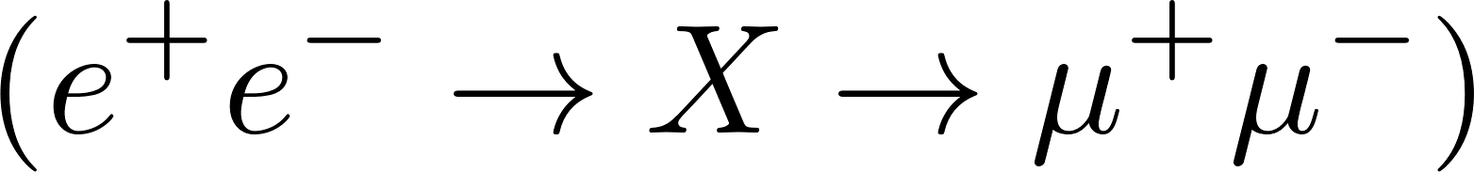
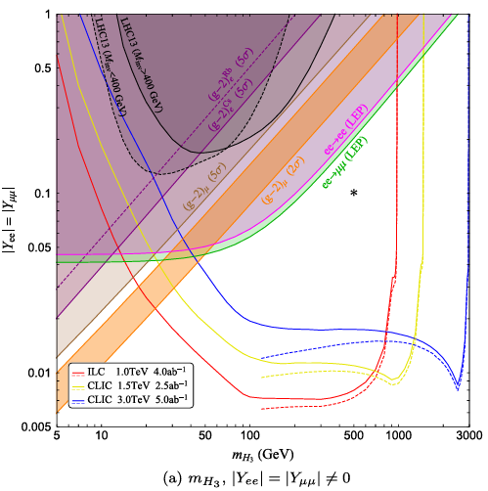
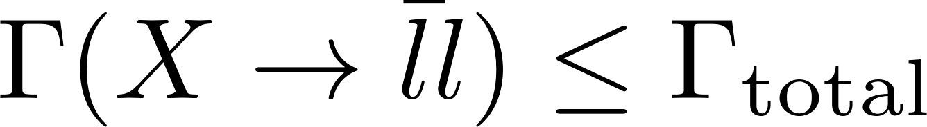
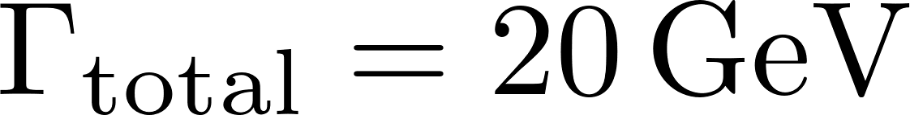
sensitivities in future lepton colliders
bound for
Large window (about 20 times) of
Yukawa coupling is accessible for ILC.
If the Yukawa coupling lies in this region,
ILC may barely detect the threshold channel…
whose cross-section is roughly similar with
the signal in this region.
Of course, factors such as detector smearing make things worse.
Xu, Fang. "Neutral and doubly charged scalars at future lepton colliders." Physical Review D 108.3 (2023): 036002. arXiv:2302.08653

Slide 8
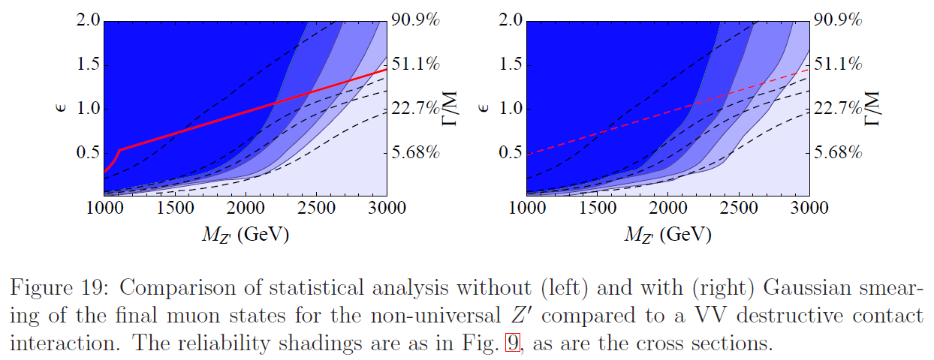
Detector smearing: Not terribly bad?
dashed lines: cross sections, shades: statistical reliability
arXiv:1011.0728
The above result is from the study about distinguishing broad resonances from contact interactions or backgrounds.
Not directly applicable for our study, but it suggests that the smearing affects the result only slightly, if the typical
momentum variance scale is bigger than the detector resolution.

